Slide 1
Talent Development
At HCL

Slide 2
Locator Techniques

Slide 3
WebElement – Locator Technique
Selenium uses locators to find and match the element in the web page.
Locators available in Selenium are
Id
Name
XPATH
CSS
Tag Name
Class name
Link Text
Partial Link Text

Slide 4
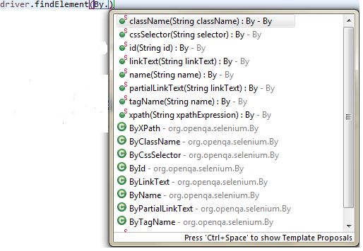
WebElement – Locator Code
The method findElement() of WebDriver is used to locate elements.

Slide 5
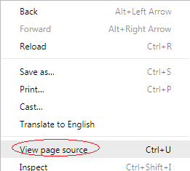
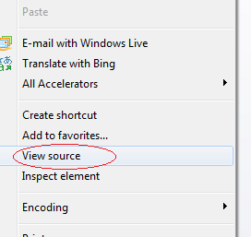
WebElement – Locator Technique
All webpages pages have underlying HTML code.
So all WebElement/ Form Elements have a unique HTML code associated with it.
To see the code, right click on the web page and select “View Page source” or “View Source”
Select “Inspect” or “Inspect Element” go see the exact code for the Web Element.

Slide 6
Using Firepath/ Firebug
We can use tools like Firepath/ Firebug to find the underlying code of any WebElement.
Prerequisite – Firepath and Firebug are already installed.
Open Firefox browser.
Navigate to the Web Page
Press “F12” key to open the Firepath Console.

Slide 7
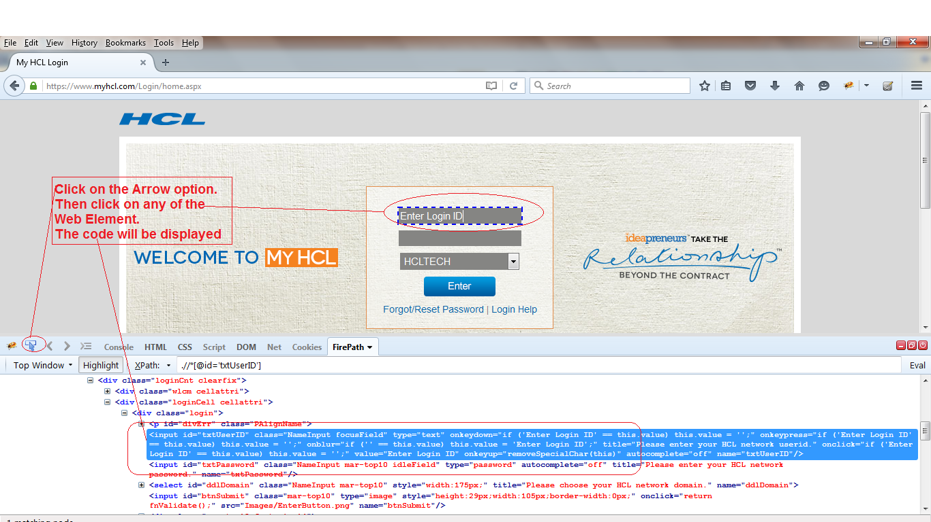
Using Firepath/ Firebug

Slide 8
WebElement Code
Let’s analyze the code.
Open Firefox browser and navigate to www.myhcl.com
Select “F12” and perform the steps as mentioned in the last slide.
The code for Login ID field is –
<input id="txtUserID" class="NameInput focusField" type="text" onkeydown="if ('Enter Login ID' == this.value) this.value = '';" onkeypress="if ('Enter Login ID' == this.value) this.value = '';" onblur="if ('' == this.value) this.value = 'Enter Login ID';" title="Please enter your HCL network userid." onclick="if ('Enter Login ID' == this.value) this.value = '';" value="Enter Login ID" onkeyup="removeSpecialChar(this)" autocomplete="off" name="txtUserID"/>

Slide 9
WebElement Code
It has all the information in the form of locators available in the form of “attribute = value”
id="txtUserID“
name="txtUserID“
The above mentioned HTML code values can be used in locator techniques like id, name etc.
So the Selenium code to find the WebElement “Login ID” by locator “id” will be
driver.findElement(By.id("txtUserID"));
And the Selenium code to find the WebElement “Login ID” by locator “name” will be
driver.findElement(By.name("txtUserID"));

Slide 10
Locating by id
The most efficient way and preferred way to locate an element on a web page is By ID.
ID will be the unique on web page which can be easily identified.
IDs are the safest and fastest locator option.
So for the HTML code
<input id="txtUserID" class="NameInput focusField" type="text" onkeydown="if ('Enter Login ID' == this.value) this.value = '';" onkeypress="if ('Enter Login ID' == this.value) this.value = '';" onblur="if ('' == this.value) this.value = 'Enter Login ID';" title="Please enter your HCL network userid." onclick="if ('Enter Login ID' == this.value) this.value = '';" value="Enter Login ID" onkeyup="removeSpecialChar(this)" autocomplete="off" name="txtUserID"/>
The locator code would be
WebElement element = driver.findElement(By.id("txtUserID"));

Slide 11
Locating by name
When there is no Id to use, the next worth seeing if the desired element has a name attribute.
But make sure that names are unique for the Web Element.
If there are multiple names, Selenium will always perform action on the first matching element
Syntax - WebElement element = driver.findElement(By.name("txtUserID"));

Slide 12
Locating by LinkText/ ParatialLinkText
Link Text locator technique is used when there is a hyperlink in the page.
Let’s see the code for “Login Help” in www.myhcl.com page.
It looks like - <a onclick="Popup('https://www.myhcl.com/Login/PasswordHelp/Login%20Related%20Help.htm','HCLTIntranetHelpDocument',750,450);" href="#">Login Help</a>
We have to use the text present in the Hyperlink as given above.
For LinkText, we need to give the complete Text.
WebElement element = driver.findElement(By.linkText("Login Help"));
For ParatialLinkText, we can give any substring.
WebElement element = driver.findElement(By.partialLinkText("Help"));

Slide 13
Locating by TagName
Tag name is HTML tag that starts with the symbol ‘<’ in HTML code.
Let’s see the code of the “Domain” dropdown.
It is - <select id="ddlDomain" class="NameInput mar-top10" style="width:175px;" title="Please choose your HCL network domain." name="ddlDomain">
Here the tag name is “Select”
So the code will be
WebElement element = driver.findElement(By.tagName("select"));

Slide 14
Locating by ClassName
If the WebElement has a unique classname associated with it, you can use the locator technique className to find it.
Syntax is - WebElement element = driver.findElement(By.className("CLASSNAME"));

Slide 15
Locator - Code

Slide 16
Code – Locator id
package Session_2_locatorTechnique;
import org.openqa.selenium.By;
import org.openqa.selenium.WebDriver;
import org.openqa.selenium.firefox.FirefoxDriver;
public class locator_id {
public static void main(String[] args) {
String url = "https://www.myhcl.com/Login/home.aspx";
WebDriver myHCL_WD = new FirefoxDriver();
myHCL_WD.get(url);
myHCL_WD.findElement(By.id("txtUserID")).sendKeys("Sangram.Swain");
myHCL_WD.findElement(By.id("txtPassword")).sendKeys("Password");
myHCL_WD.findElement(By.id("ddlDomain")).sendKeys("HCLTECH");
myHCL_WD.findElement(By.id("btnSubmit")).click();
}
}

Slide 17
Code – Locator name
import org.openqa.selenium.By;
import org.openqa.selenium.WebDriver;
import org.openqa.selenium.firefox.FirefoxDriver;
public class locator_name {
public static void main(String[] args) {
// TODO Auto-generated method stub
String url = "https://www.myhcl.com/Login/home.aspx";
WebDriver myHCL_WD = new FirefoxDriver();
myHCL_WD.get(url);
myHCL_WD.findElement(By.name("txtUserID")).sendKeys("Sangram.Swain");
myHCL_WD.findElement(By.name("txtPassword")).sendKeys("Password");
myHCL_WD.findElement(By.name("ddlDomain")).sendKeys("HCLTECH");
myHCL_WD.findElement(By.name("btnSubmit")).click();
}
}

Slide 18
Code – Locator tagName
import org.openqa.selenium.By;
import org.openqa.selenium.WebDriver;
import org.openqa.selenium.firefox.FirefoxDriver;
public class locator_tagname {
public static void main(String[] args) {
String url = "https://www.myhcl.com/Login/home.aspx";
WebDriver myHCL_WD = new FirefoxDriver();
myHCL_WD.get(url);
myHCL_WD.findElement(By.tagName("Select")).sendKeys("GEO");
myHCL_WD.findElement(By.tagName("a")).click();
}
}

Slide 19
Code – Locator className
import org.openqa.selenium.By;
import org.openqa.selenium.WebDriver;
import org.openqa.selenium.chrome.ChromeDriver;
public class locator_className {
public static void main(String[] args) {
String url = "http://www.seleniumframework.com/demo-sites/";
System.setProperty("webdriver.chrome.driver", "D:\\Selenium\\ChromeServer\\chromedriver.exe");
WebDriver sel_WD = new ChromeDriver();
sel_WD.get(url);
sel_WD.findElement(By.name("message")).sendKeys("Typing message");
//sel_WD.findElement(By.className("submit")).click();
sel_WD.findElement(By.className("clear-form")).click();
}
}

Slide 20
Code – Locator linkText
package Session_2_locatorTechnique;
import org.openqa.selenium.By;
import org.openqa.selenium.WebDriver;
import org.openqa.selenium.firefox.FirefoxDriver;
public class locator_linkText {
public static void main(String[] args) {
// TODO Auto-generated method stub
String url = "https://www.myhcl.com/Login/home.aspx";
WebDriver myHCL_WD = new FirefoxDriver();
myHCL_WD.get(url);
//myHCL_WD.findElement(By.linkText("Login Help")).click();
myHCL_WD.findElement(By.partialLinkText("Help")).click();
}
}

Slide 21
Code – Locator partiallinkText
package Session_2_locatorTechnique;
import org.openqa.selenium.By;
import org.openqa.selenium.WebDriver;
import org.openqa.selenium.firefox.FirefoxDriver;
public class locator_PartialLinkText {
public static void main(String[] args) {
// TODO Auto-generated method stub
String url = "https://www.myhcl.com/Login/home.aspx";
WebDriver myHCL_WD = new FirefoxDriver();
myHCL_WD.get(url);
myHCL_WD.findElement(By.partialLinkText("Forgot/Reset")).click();
}
}

Slide 22
Code – Locator cssSelector
package Session_2_locatorTechnique;
import org.openqa.selenium.By;
import org.openqa.selenium.WebDriver;
import org.openqa.selenium.firefox.FirefoxDriver;
public class locator_CSSSelector {
public static void main(String[] args) {
// TODO Auto-generated method stub
String url = "https://www.myhcl.com/Login/home.aspx";
WebDriver ff_WD = new FirefoxDriver();
ff_WD.get(url);
ff_WD.findElement(By.cssSelector("#txtUserID")).sendKeys("Sangram.Swain");
ff_WD.findElement(By.cssSelector("#txtPassword")).sendKeys("Password");
ff_WD.findElement(By.cssSelector("#ddlDomain")).sendKeys("HCLTECH");
ff_WD.findElement(By.cssSelector("#btnSubmit")).click();
}
}

Slide 23
Code
Download the code from https://github.com/sangramkswain/HCLPuneTraining
File Name – Sessions.zip

